Slide 1
Class of 2017–
The Road To Graduation and Post-Secondary
November 16, 2016

Slide 2

Agenda For Today…
Grade 12 Survival Tips
Career Centre
Scholarships
PSI
Post Secondary Options
Post Secondary Entrance Requirements
Applying to Post Secondary
Grad Info
Questions

Slide 3
Advice for students from Previous Grade 12’s:
Read the Howl daily (on the website)
Make sure you will meet Graduation Requirements
Visit the Career Facilitator
Attend as many post secondary information sessions as possible (several happening now)
Apply to more than 1 school (have a back up plan)
Finish Your Grad Transitions
Stay organized
Apply for Scholarships

Slide 4
Financial Aid
Grade 11 & 12 marks are often considered
You may get money for many reasons: grades, involvement in school, volunteer work, financial need, parent association with organizations…
You must APPLY to be eligible
Make sure you have a Social Insurance Number

Slide 5
Scholarships
External Scholarships
University Entrance Scholarships
Provincial Scholarships
Local Scholarships
District Scholarships- Meeting in March 2017
  Also refer to Ms. Moorhouse’s website

Slide 6
Career Facilitator
Mrs. Moorhouse
http://www.sd43.bc.ca/school/pinetree/ProgramsServices/career/Pages/default.aspx
Scholarship Information
Financial Aid
Post Secondary Information
Career Information

Slide 7
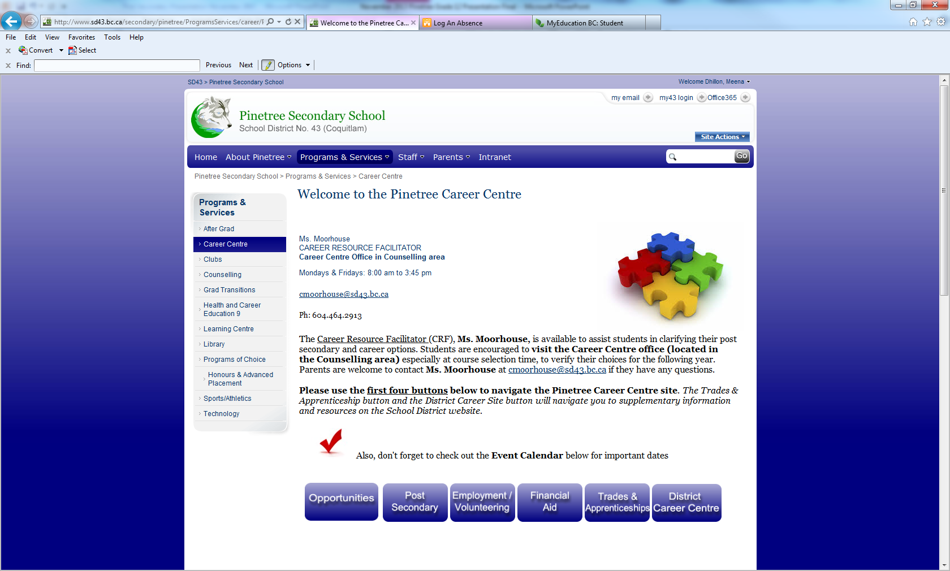
CAREER CENTRE

Slide 8
Post Secondary Education: Simon Fraser University
General Admission:
Graduation
English 11 & 12
Socials 11
Precalculus 11 or Foundations of Mathematics 11
Language 11 (beginner language 11 or higher)
Academic Science 11
Entrance Averages:
Based on 4 Grade 12 Courses
English 12
3 other academic 12’s
BC First Nations Studies 12 , Biology 12, Calculus 12, Chemistry 12, Comparative Civilizations 12, Economics 12, English Lit 12, Pre-Calculus 12, French 12, Geography 12, History 12, Japanese 12, Law 12, Mandarin 12, Physics 12, Spanish 12
Note: SFU Accepts Language Challenge exams for admission purposes.

Slide 9
SFU has Quantitative and English Language Skills Requirements
  Generally:
  70% in Foundations of Math 11, Precalculus 11 or Precalculus 12 depending on the program you are applying to (if your mark is below 60%- will not be considered for entrance)
  AND
  75% or higher in English 12 (final blended- in order to take a first year English course)
  Not meeting – there are options
  You can still be accepted but may be required to complete an additional course once you enter SFU

Slide 10
Post Secondary Education: UBC Vancouver / Okanagan
General Admission
Grade 11 Course Requirements:
English 11, Social Studies 11, Pre-Calculus 11, a Language 11
  Beginner’s is not accepted, External Lang 11 is accepted
  Language requirement not needed for UBC Okanagan
an Academic Science 11 (Bi 11, Ch 11, E. Sc 11, Ph 11)
Language Challenge Courses:
Not accepted for admission averages
Can be used to satisfy general admission requirement such as a language 11 or language 12 requirement for the Faculty of Arts Degree program

Slide 11
Post Secondary Education: UBC Vancouver / Okanagan
Holistic Admissions:
Criteria for Competitive Assessment
Secondary School Grades
  Combination of 11’s and 12’s
  UBC Faculty admission average
  Course-specific minima (TBD by Faculty)
Personal profile
  4-7 short essay questions
Supplemental info as required for specific faculties

Slide 12
ONLINE COURSES
If you are enrolled in an online course that would be considered an approved course or required course for University Entrance to be calculated in your entrance average, be aware of the following deadlines:
  UBC- must complete the course by February 1st, 2017
  SFU- must complete the course by April 30th, 2017

Slide 13
Post Secondary Education: University of Victoria
General Admission Requirements
Admission Averages are based on
  English 12 and three additional approved academic grade 12 courses
Grade 11 requirements
  English 11, Social Studies 11, Pre-calculus 11 or Foundations of Math 11 (depending on the faculty), an Academic Science 11 (Bi 11, Ch 11, E. Sc 11, Ph 11),
  No second language needed
  Check the website for approved grade 12 courses for each faculty
  http://registrar.uvic.ca/undergrad/admissions/requirements/bc.html

Slide 14
Post Secondary Education: University of Toronto
Basic Admission Requirements
English 12 plus 4 academic courses
Average will be calculated on English 12 plus these 4 subjects except for Engineering (5 required courses including English)
Note: Language Challenge Course Marks are not acceptable
Note: for online courses 50% of the course must be done to be considered for admission (U of T will accept a mid-term mark)
Business, Engineering and Architecture require supplemental info

Slide 15
Post Secondary Education: University of Toronto
University of Toronto’s Policy on Repeated Courses:
Individual programs at U of T reserve the right to give preference to students whose marks are the result of a first attempt at each course, particularly in prerequisite subjects
Faculty of Applied Science and Engineering generally consider first attempts ONLY.
Rotman Commerce Program will ONLY consider the first attempt in all courses.

Slide 16
McGill University
Entrance Requirements
Based on the average of their top five grade 12 academic courses
http://www.mcgill.ca and go to the site below to see the list of approved BC courses:
http://www.mcgill.ca/undergraduate-admissions/sites/mcgill.ca.undergraduate-admissions/files/bc_and_yt_academic_courses.pdf
Of the five courses used for admission at least 4 must be from their approved academic course list.
Please note the following policy McGill uses in calculating the admission average:
  Admission to McGill University is based on an average of the results of five academic Grade 12 level courses (regardless of the calendar year in which they were taken), including all the required prerequisites. Generally speaking, all marks are taken into consideration in determining admission, including those of failed or repeated courses.
Deadline to Apply: February 1, 2017

Slide 17
Douglas College
www.douglas.bc.ca
Different deadlines and entrance requirements
for each program. Check carefully!
Required final blended English 12 C or Comm 12 B
If you are applying to a university transfer program your registration date for courses depends on your GPA! The higher it is, the earlier your registration date!
Applications are now being accepted!

Slide 18
University Options in BC
UBC, SFU, UVIC, UNBC
Capilano University
Kwantlen Polytechnic University
Trinity Western University
Emily Carr University of Art and Design
BCIT
Thomson Rivers University
University of the Fraser Valley
Vancouver Island University

Slide 19
BCIT
Burnaby/Richmond/Marine/Downtown/Great Northern Way
www.bcit.ca
Each program has its own specific admission requirements.
Specific Intake Program (Technology):
Academic – different high school course requirements for each
program (some programs require some post secondary)
Meeting minimum prerequisites does not guarantee you a seat in a
competitive program
Applications accepted until program seats are filled
Continual Intake Program (Trades Foundation & Technical):
Must have completed the minimum admission requirements for first
available seat (will be put on a waiting list – Electrical Trades has
a 2 year waitlist! Check length of waitlist by contacting BCIT.)

Slide 20
Timeline – December - March
DECEMBER/JANUARY
UBC- Admissions deadline for Major Entrance Scholarship Consideration is December 1, 2016
UBC Final deadline to apply is January 15, 2017
Ontario Universities (OUAC) –recommended January 11, 2017
FEBRUARY/MARCH
Due date for applications for SFU, TWU and UVIC: Feb 28th, 2017
McGill: Feb. 1, 2017
Capilano University- March 31, 2017
Kwantlen Polytechnic University- March 1, 2017
BCIT- application deadline throughout the year depending on program
Douglas College –open enrolment programs –April 2017 but deadlines are program specific
Notes:
Name of new counsellor for scholarships

Slide 21
PSI
Online Post Secondary Institution Selections
It is important that all Grade 12 Students planning to attend a post-secondary institution after graduation must complete this document online
Students' PSI selections must be submitted by April 30th for Interim transcript information to be forwarded to BC and Ontario Universities Application Centre.
The PSI Selection form is now available online for students graduating this year. Students can access this online form by logging into the student secure Web site.
Go to the following Link: https://www.bced.gov.bc.ca/exams/tsw/tsw/student/
Will be done through your English 12 classes:
Semester 1 - December 5, 2016
Semester 2- February 6, 2017

Slide 22
What if I don’t know……
3 possible scenarios….
Decided on a faculty
Debating between a few faculties
Open to possibilities

Slide 23
You need to know its okay if you are not certain!
A Majority of students (50-70%) will change their major/faculty at least once
There is not always a linear connection between your major of study and career possibilities
There is value in exploring even once you’ve entered the post-secondary institution of your choice.

Slide 24



Three Outcomes of Exploring:

Slide 25
Sometimes…
Trying new things leads to great results
You need to keep in mind your…
  Interests and Strengths
Your experiences will help guide you to develop the path you end up taking
All of the above will help you put the pieces of the puzzle together

Slide 26
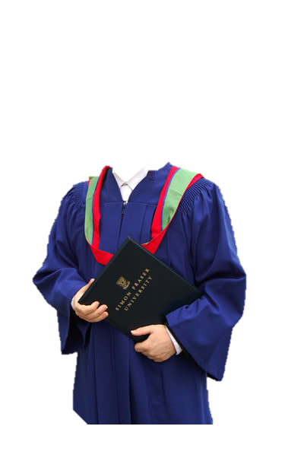

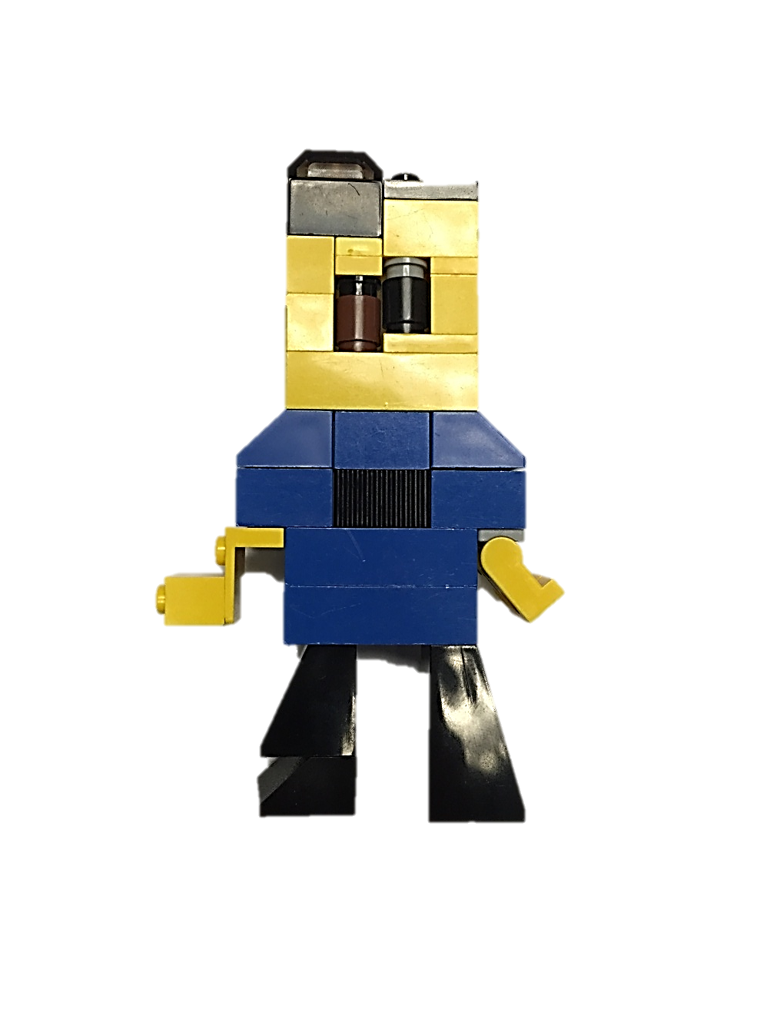
Convocation
The club you joined
An elective
An elective
Your Major
Your Major
That paper you wrote
Your Minor
Your major
That book you read
Your major
An elective
THAT class!
That chat with your prof
YOUR MAJOR
Your volunteer role(s)
Your first co-op

Slide 27
Summary- if you are not sure it’s okay!
Explore
  Think interests & strengths
  Pick what’s right at the time
Stay open
  You’ve got time
  It’s ok to change your mind
Take action
  Career paths are complex
  Exploration doesn’t happen on its own

Slide 28
Questions?
Please visit see your Counsellor or Mrs. Moorehouse

